Slide 1
AI-900 Exam Prep
Presenter: John Deardurff
August 2025

Slide 2





Agenda
Exam Information
What is Artificial Intelligence?
What is Machine Learning?
What are Azure AI Services?
What is Generative AI?

Slide 3
Exam Basics
45 Questions
45 Minutes
700 Passing Score
Understand the skills measured by the exam
Study area | Percentage
Describe Artificial Intelligence workloads and considerations | 15-20%
Describe fundamental principles of machine learning on Azure | 15-20%
Describe features of computer vision workloads on Azure | 15-20%
Describe features of Natural Language Processing (NLP) workloads on Azure | 15-20%
Describe features of Generative AI workloads on Azure | 20-25%
Percentages indicate the relative weight of each area on the exam
The higher the percentage, the more questions you are likely to see in that area

Slide 4
AI-900 Exam Resources
Microsoft Certified: Azure AI Fundamentals
Microsoft Learn: Certification Page
Microsoft Learn Study Guide for Exam AI-900
Practice Assessment for AI-900
Microsoft Learn – Learning Paths
Introduction to AI in Azure
AI security fundamentals
Introduction to generative AI for Trainers
John Savill’s Study Videos (2 Hours)
AI-900 - Study Cram v2 (Non-Generative AI)
AI-900 - Learning About Generative AI
Coursera (8 Hours)
Azure AI Fundamentals AI-900 Exam Prep
On-Demand Instructor-Led Training Series
AI-900: Fundamentals of Artificial Intelligence
AI-900: Fundamentals of Computer Vision
AI-900: Fundamentals of Natural Language
AI-900: Fundamentals of Document Intelligence
AI-900: Fundamentals of Generative AI

Slide 5
What is Artificial Intelligence?
Describe Artificial Intelligence workloads and considerations

Slide 6
Describe Artificial Intelligence workloads and considerations (15-20%)
Identify features of common AI workloads
Identify computer vision workloads
Identify natural language processing workloads
Identify document processing workloads
Identify features of generative AI workloads
Identify guiding principles for responsible AI
Describe considerations for fairness in an AI solution
Describe considerations for reliability and safety in an AI solution
Describe considerations for privacy and security in an AI solution
Describe considerations for inclusiveness in an AI solution
Describe considerations for transparency in an AI solution
Describe considerations for accountability in an AI solution
Notes:
Introduction to AI in Azure - Training | Microsoft Learn
AI security fundamentals - Training | Microsoft Learn

Slide 7
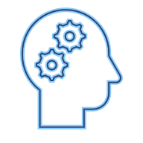
What is Artificial Intelligence?
Software that imitates human capabilities
Predicting outcomes and recognizing patterns based on historic data.
Recognizing abnormal events and making decisions.
Interpreting visual input.
Understanding language and engaging in conversations.
Extracting information from sources to gain knowledge.
Notes:
These are all things that most humans do on a day-to-day basis, often subconsciously:
We make predictions or recognize patterns using the information we have available and our past experience to guide us.
We can intuitively know when something isn’t quite right or doesn't fit an expected pattern.
We use sight to experience the world visually.
We communicate by writing and speaking, and engage in dynamic conversations, responding appropriately.
We can extract information from multiple sources to extend our knowledge

Slide 8
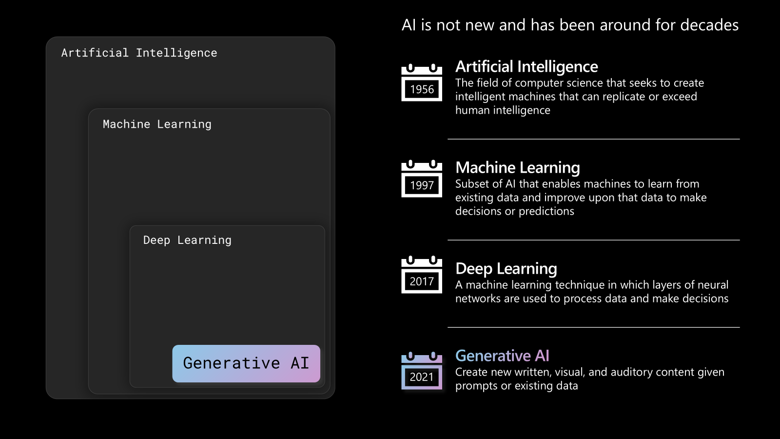
What is Artificial Intelligence?
Notes:
The history of artificial intelligence (AI) from 1956 to today is a fascinating journey marked by breakthroughs, setbacks, and transformative innovations. Here's a high-level timeline highlighting key developments:
1956–1970: The Birth of AI
1956: The term Artificial Intelligence was coined at the Dartmouth Conference, organized by John McCarthy, Marvin Minsky, Nathaniel Rochester, and Claude Shannon. This event is considered the birth of AI as a field.
Early AI research focused on symbolic reasoning and problem-solving. Programs like the Logic Theorist (1955) and General Problem Solver (1957) demonstrated early promise.
Optimism was high; researchers believed machines would soon match human intelligence.
1970s: The First AI Winter
Progress slowed due to limitations in computing power and unrealistic expectations.
Funding declined as early systems failed to scale or generalize.
Despite setbacks, expert systems began to emerge, using rule-based logic to mimic human decision-making in narrow domains.
1980s: Expert Systems and Revival
AI saw a resurgence with expert systems like XCON at Digital Equipment Corporation, which helped configure computer systems.
The development of machine learning concepts began to take shape, including neural networks and backpropagation (popularized in 1986 by Rumelhart, Hinton, and Williams).
Japan’s Fifth Generation Computer Project spurred global interest, though it ultimately fell short of its goals.
1990s: Statistical Learning and Real-World Success
AI shifted toward probabilistic reasoning, Bayesian networks, and support vector machines.
IBM’s Deep Blue defeated world chess champion Garry Kasparov in 1997, showcasing AI’s potential in strategic games.
AI began to be used in practical applications like speech recognition and fraud detection.
2000s: Big Data and Machine Learning
The rise of the internet and digital data enabled machine learning algorithms to thrive.
Support vector machines, decision trees, and ensemble methods like random forests gained popularity.
AI was increasingly used in search engines, recommendation systems, and natural language processing.
2010s: Deep Learning Revolution
2012: A major breakthrough came with AlexNet, a deep convolutional neural network that won the ImageNet competition, dramatically improving image classification.
Deep learning became the dominant paradigm, powered by GPUs and large datasets.
AI achieved superhuman performance in games like Go (AlphaGo by DeepMind in 2016).
Virtual assistants (Siri, Alexa), autonomous vehicles, and real-time translation became mainstream.
2021: Rise of Generative AI
Generative AI models like GPT-3 (released in 2020 by OpenAI) demonstrated the ability to generate coherent text, code, and even poetry.
These models used transformer architectures, introduced in the 2017 paper Attention Is All You Need.
Generative AI expanded into image generation (e.g., DALL·E), music, and video synthesis.
The focus shifted from narrow AI to foundation models capable of generalizing across tasks.

Slide 9









Common AI Workloads
 | Machine Learning | Predictive models based on data and statistics – the foundation for AI.
 | Generative AI | Capabilities within AI that create original content in a variety of formats including natural language, image, code, and more.
 | Natural Language Processing | Capabilities within AI for a computer to interpret written or spoken language and respond appropriately.
 | Computer Vision | Capabilities within AI to interpret the world visually through cameras, video, and images.
 | Information Extraction | Capabilities within AI that deal with managing, extracting, and processing high volumes of data found in all types of content.
Notes:
The slide lists common workloads or "areas" of AI. We'll explore each of these workloads in detail, but for now just point out that in many solutions, the workloads may overlap.
For example, imagine a generative AI solution that uses an agent to process an auto insurance claim. The agent relies on some natural language processing capabilities to make sense of input such as "I want to submit a claim". It may allow users to send a photograph of a damaged vehicle, use computer vision to assess the damage, and apply a machine learning model to predict likely repair costs. The bot might also use information extraction to identify potentially fraudulent claims. Finally, the claims data, including forms, photographs, and other artifacts might be indexed to extract insights and create a searchable knowledge store to help manage future claims.

Slide 10






Principles of Responsible AI
 | Challenge or Risk | Example
Fairness | Bias can affect results. | A loan-approval model discriminates by gender due to bias in the data with which it was trained.
Reliability & safety | Errors may cause harm. | An autonomous vehicle experiences a system failure and causes a collision.
Privacy & security | Private data could be exposed. | A medical diagnostic bot is trained using sensitive patient data, which is stored insecurely.
Inclusiveness | Solutions may not work for everyone. | A predictive app provides no audio output for visually impaired users.
Transparency | Users must trust a complex system. | An AI-based financial tool makes investment recommendations – what are they based on?
Accountability | Who’s liable for AI-driven decisions? | An innocent person is convicted of a crime based on evidence from facial recognition – who’s responsible?
Notes:
At Microsoft, AI software development is guided by a set of six principles for responsible AI.
Use the summaries below to relate these to the challenges and risks on the previous slide.
Fairness AI systems should treat all people fairly. For example, suppose you create a machine learning model to support a loan approval application for a bank. The model should make predictions of whether the loan should be approved without incorporating any bias based on gender, ethnicity, or other factors that might result in an unfair advantage or disadvantage to specific groups of applicants.
Azure Machine Learning includes the capability to interpret models and quantify the extent to which each feature of the data influences the model's prediction. This capability helps data scientists and developers identify and mitigate bias in the model.
Reliability and safety AI systems should perform reliably and safely. For example, consider an AI-based software system for an autonomous vehicle; or a machine learning model that diagnoses patient symptoms and recommends prescriptions. Unreliability in these kinds of system can result in substantial risk to human life.
AI-based software application development must be subjected to rigorous testing and deployment management processes to ensure that they work as expected before release.
Privacy and security AI systems should be secure and respect privacy. The machine learning models on which AI systems are based rely on large volumes of data, which may contain personal details that must be kept private. Even after the models are trained and the system is in production, it uses new data to make predictions or take action that may be subject to privacy or security concerns.
Inclusiveness AI systems should empower everyone and engage people. AI should bring benefits to all parts of society, regardless of physical ability, gender, sexual orientation, ethnicity, or other factors.
Transparency AI systems should be understandable. Users should be made fully aware of the purpose of the system, how it works, and what limitations may be expected.
Accountability People should be accountable for AI systems. Designers and developers of AI-based solution should work within a framework of governance and organizational principles that ensure the solution meets ethical and legal standards that are clearly defined.

Slide 11
What is Machine Learning?
Describe fundamental principles of machine learning on Azure

Slide 12
Describe fundamental principles of machine learning on Azure (15-20%)
Identify common machine learning techniques
Identify regression machine learning scenarios
Identify classification machine learning scenarios
Identify clustering machine learning scenarios
Identify features of deep learning techniques
Identify features of the Transformer architecture
Describe core machine learning concepts
Identify features and labels in a dataset for machine learning
Describe how training and validation datasets are used in machine learning
Describe Azure Machine Learning capabilities
Describe capabilities of automated machine learning
Describe data and compute services for data science and machine learning
Describe model management and deployment capabilities in Azure Machine Learning
Notes:
Introduction to AI in Azure - Training | Microsoft Learn

Slide 13




What is Machine Learning?
Machine Learning is creating predictive models by finding relationships in data
Multiple training iterations with different algorithms and parameters
1. Training data
(past observations)
2. Algorithm
(Generalizes the relationship between x and y as a function)
3. Model
(encapsulates the function)
[x₁,x₂,x₃], y
[x₁,x₂,x₃], y
[x₁,x₂,x₃], y
[x₁,x₂,x₃], y
[x₁,x₂,x₃], y
70%
y = f(x)
5. Evaluate model (compare predicted labels to actual labels)
[x₁,x₂,x₃], y
[x₁,x₂,x₃], y
[x₁,x₂,x₃], y
30%
4. Predictions
(from the validation data)
Features
(x)
Label
(y)
Validation data
(with known labels)
Notes:
Split the data into a training set and a validation set (Typically 70% for training and 30% for Validation. The training data consists of past observations. In most cases, the observations include the observed attributes or features of the thing being observed, and the known value of the thing you want to train a model to predict (known as the label). In mathematical terms, you'll often see the features referred to using the shorthand variable name x, and the label referred to as y. Usually, an observation consists of multiple feature values, so x is actually a vector (an array with multiple values), like this: [x₁,x₂,x₃,...].
2. Apply an algorithm to fit the training data to a model. An algorithm is applied to the data to try to determine a relationship between the features and the label, and generalize that relationship as a calculation that can be performed on x to calculate y. The specific algorithm used depends on the kind of predictive problem you're trying to solve (more about this later), but the basic principle is to try to fit the data to a function in which the values of the features can be used to calculate the label.
3. The result of the algorithm is a model that encapsulates the calculation derived by the algorithm as a function - let's call it f. In mathematical notation: y = f(x)
4. Use the model to generate predictions from the validation data. Now that the training phase is complete, the trained model can be used for inferencing. The model is essentially a software program that encapsulates the function produced by the training process. You can input a set of feature values and receive as an output a prediction of the corresponding label. Because the output from the model is a prediction that was calculated by the function, and not an observed value, you'll often see the output from the function shown as ŷ (which is rather delightfully verbalized as "y-hat").
5. Use evaluation metrics to compare predicted vs actual labels (supervised) or measure cluster separation (unsupervised)
Repeat…
The learning component of machine learning occurs during training. We try to capture the relationships between the features and label in a model. Training is the action of iterating on an algorithm to best fit, or encapsulate those relationships.
After training, we have a model that we can test. We can use some of the data set aside, validation data, to test how closely our model's predicted labels are to actual labels. In the case of unsupervised learning where we don't know the actual labels, we measure how well our model's predicted labels were at separating clusters. There are many types of evaluation metrics. The important thing to remember is that the goal of machine learning is to find a model that gets as close as possible to predicting the actual label. The best model can still have some margin of error.

Slide 14

Features and Labels
Scenario: Predicting Ice Cream Sales
Imagine you're trying to build a model that predicts how many ice creams you'll sell on a given day. The model learns patterns from this and starts predicting future sales based on new conditions.
Features: The input clues you give a training model
Temperature | Weather | Day | Holiday | People Nearby | Ice Creams Sold
85°F | Sunny | Sat | Yes | 300 | 150
70°F | Cloudy | Tue | No | 120 | 45
90°F | Sunny | Sun | No | 400 | 180
Label: The answer you want the model to predict (Numeric = Regression, Text = Classification)
Notes:
Scenario: Predicting Ice Cream Sales
Imagine you're trying to build a model that predicts how many ice creams you'll sell on a given day.
Features (the clues you give the model):
These are the things that might affect ice cream sales:
Temperature (e.g., 85°F)
Weather condition (e.g., sunny, cloudy, rainy)
Day of the week (e.g., Saturday vs. Monday)
Is it a holiday? (Yes or No)
Time of day (e.g., afternoon vs. evening)
Number of people passing by your shop
Label (the answer you want the model to predict):
Number of ice creams sold (e.g., 120 cones)
How it works:
You feed the model lots of past data like:
Temperature-Weather-Day-Holiday-People
The model learns patterns from this and starts predicting future sales based on new conditions.
Want to try building a pretend dataset together or visualize this with a chart?

Slide 15




















Types of Machine Learning
Machine Learning
Supervised machine learning
Training data includes known labels
Unsupervised machine learning
Training data is unlabeled
Regression
Label is a numeric value
Classification
Label is a categorization (or class)
Clustering
Similar items are grouped together
Binary classification
Label is or is not a class
Multiclass classification
Label is one of multiple classes
5
Predict the number of ice creams sold based on day, season, and weather
Separate plants into groups based on common characteristics
Predict whether a patient is at-risk for diabetes based on clinical data
Predict the species of a penguin based on its measurements
Notes:
Supervised machine learning
Supervised machine learning is a general term for machine learning algorithms in which the training data includes both feature values and known label values. Supervised machine learning is used to train models by determining a relationship between the features and labels in past observations, so that unknown labels can be predicted for features in future cases.
Regression
Regression is a form of supervised machine learning in which the label predicted by the model is a numeric value. For example:
The number of ice creams sold on a given day, based on the temperature, rainfall, and windspeed.
The selling price of a property based on its size in square feet, the number of bedrooms it contains, and socio-economic metrics for its location.
The fuel efficiency (in miles-per-gallon) of a car based on its engine size, weight, width, height, and length.
Classification
Classification is a form of supervised machine learning in which the label represents a categorization, or class. There are two common classification scenarios.
Binary classification
In binary classification, the label determines whether the observed item is (or isn't) an instance of a specific class. Or put another way, binary classification models predict one of two mutually exclusive outcomes. For example:
Whether a patient is at risk for diabetes based on clinical metrics like weight, age, blood glucose level, and so on.
Whether a bank customer will default on a loan based on income, credit history, age, and other factors.
Whether a mailing list customer will respond positively to a marketing offer based on demographic attributes and past purchases.
In all of these examples, the model predicts a binary true/false or positive/negative prediction for a single possible class.
Multiclass classification
Multiclass classification extends binary classification to predict a label that represents one of multiple possible classes. For example,
The species of a penguin (Adelie, Gentoo, or Chinstrap) based on its physical measurements.
The genre of a movie (comedy, horror, romance, adventure, or science fiction) based on its cast, director, and budget.
In most scenarios that involve a known set of multiple classes, multiclass classification is used to predict mutually exclusive labels. For example, a penguin can't be both a Gentoo and an Adelie. However, there are also some algorithms that you can use to train multilabel classification models, in which there may be more than one valid label for a single observation. For example, a movie could potentially be categorized as both science fiction and comedy.
Unsupervised machine learning
Unsupervised machine learning involves training models using data that consists only of feature values without any known labels. Unsupervised machine learning algorithms determine relationships between the features of the observations in the training data.
Clustering
The most common form of unsupervised machine learning is clustering. A clustering algorithm identifies similarities between observations based on their features, and groups them into discrete clusters. For example:
Group similar flowers based on their size, number of leaves, and number of petals.
Identify groups of similar customers based on demographic attributes and purchasing behavior.
In some ways, clustering is similar to multiclass classification; in that it categorizes observations into discrete groups. The difference is that when using classification, you already know the classes to which the observations in the training data belong; so the algorithm works by determining the relationship between the features and the known classification label. In clustering, there's no previously known cluster label and the algorithm groups the data observations based purely on similarity of features.
In some cases, clustering is used to determine the set of classes that exist before training a classification model. For example, you might use clustering to segment your customers into groups, and then analyze those groups to identify and categorize different classes of customer (high value - low volume, frequent small purchaser, and so on). You could then use your categorizations to label the observations in your clustering results and use the labeled data to train a classification model that predicts to which customer category a new customer might belong.
How this relates to x and y from the previous slide:
In the ice cream sales scenario, our goal is to train a model that can predict the number of ice cream sales based on the weather. The weather measurements for the day (temperature, rainfall, windspeed, and so on) would be the features (x), and the number of ice creams sold on each day would be the label (y).
In the medical scenario, the goal is to predict whether or not a patient is at risk of diabetes based on their clinical measurements. The patient's measurements (weight, blood glucose level, and so on) are the features (x), and the likelihood of diabetes (for example, 1 for at risk, 0 for not at risk) is the label (y).
In the Antarctic research scenario, we want to predict the species of a penguin based on its physical attributes. The key measurements of the penguin (length of its flippers, width of its bill, and so on) are the features (x), and the species (for example, 0 for Adelie, 1 for Gentoo, or 2 for Chinstrap) is the label (y).

Slide 16
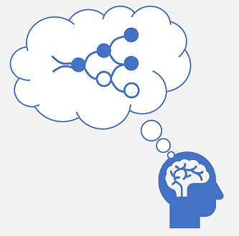

Deep Learning
Human neural network
Artificial neural network
x
w
∫( )
f (x,w)
Neurons fire in response to electrochemical stimuli
When fired, the signal is passed to connected neurons
Each neuron is a function that operates on an input value (x) and a weight (w)
The function is wrapped in an activation function that determines whether to pass the output on
Notes:
Deep learning is an advanced form of machine learning that tries to emulate the way the human brain learns. The key to deep learning is the creation of an artificial neural network that simulates electrochemical activity in biological neurons by using mathematical functions.
Artificial neural networks are made up of multiple layers of neurons - essentially defining a deeply nested function. This architecture is the reason the technique is referred to as deep learning and the models produced by it are often referred to as deep neural networks (DNNs). You can use deep neural networks for many kinds of machine learning problem, including regression and classification, as well as more specialized models for natural language processing and computer vision.

Slide 17










Deep Learning Transformer Example A (very) high-level overview
Transformer Model
Training text
Encoder
Output as vectors (embeddings)
 | dog | [10,3,2]
 | cat | [10,3,1]
 | puppy | [5,2,1]
 | skateboard | [-3, 3, 2]
Text broken into tokens
Training
Input
(prompt)
Decoder
Embedding vectors encapsulate semantic attributes in multiple dimensions
(related words have similar orientation)
When my dog was…
Generate natural language sequences
Output
(completion)
… a puppy
Inferencing
Notes:
The model is trained with a large volume of natural language text, often sourced from the internet or other public sources of text. Common Crawl - Example Projects
2. The sequences of text are broken down into tokens (for example, individual words) and the encoder block processes these token sequences using a technique called attention to determine relationships between tokens (for example, which tokens influence the presence of other tokens in a sequence, different tokens that are commonly used in the same context, and so on.)
Tiktokenizer
3. The output from the encoder is a collection of vectors (multi-valued numeric arrays) in which each element of the vector represents a semantic attribute of the tokens. These vectors are referred to as embeddings.
4. The decoder block works on a new sequence of text tokens and uses the embeddings generated by the encoder to generate an appropriate natural language output.
5. For example, given an input sequence like "When my dog was", the model can use the attention technique to analyze the input tokens and the semantic attributes encoded in the embeddings to predict an appropriate completion of the sentence, such as "a puppy".
While the mathematical principles behind language models can be complex, a basic understanding of the architecture used to implement them can help you gain a conceptual understanding of how they work.
Today's cutting-edge large language models are based on the transformer architecture, which builds on and extends some techniques that have been proven successful in modeling vocabularies to support NLP tasks - and in particular in generating language. Transformer models are trained with large volumes of text, enabling them to represent the semantic relationships between words and use those relationships to predict probable sequences of text that make sense. Transformer models with a large enough vocabulary are capable of generating language responses that are tough to distinguish from human responses.
In practice, the specific implementations of the architecture vary – for example, the Bidirectional Encoder Representations from Transformers (BERT) model developed by Google to support their search engine uses only an encoder block to generate semantic vector representations of text, while the Generative Pretrained Transformer (GPT) model developed by OpenAI uses only a decoder block to generate sequences of natural language.
While a complete explanation of every aspect of transformer models is beyond the scope of this module, an explanation of some of the key elements in a transformer can help you get a sense for how they support generative AI.
The first step in training a transformer model is to decompose the training text into tokens - in other words, identify each unique text value. For the sake of simplicity, you can think of each distinct word in the training text as a token. Though in reality, tokens can be generated for partial words, or combinations of words and punctuation. With a sufficiently large set of training text, a vocabulary of many thousands of tokens could be compiled.
While it may be convenient to represent tokens as simple IDs - essentially creating an index for all the words in the vocabulary, they don't tell us anything about the meaning of the words, or the relationships between them. To create a vocabulary that encapsulates semantic relationships between the tokens, language models define contextual vectors, known as embeddings, for them. Vectors are multi-valued numeric representations of information, for example [10, 3, 1] in which each numeric element represents a particular attribute of the information. For language tokens, each element of a token's vector represents some semantic attribute of the token. The specific categories for the elements of the vectors in a language model are determined during training based on how commonly words are used together or in similar contexts.
Vectors represent lines in multidimensional space, describing direction and distance along multiple axes (you can impress your mathematician friends by calling these amplitude and magnitude). It can be useful to think of the elements in an embedding vector for a token as representing steps along a path in multidimensional space. For example, a vector with three elements represents a path in 3-dimensional space in which the element values indicate the units traveled forward/back, left/right, and up/down. Overall, the vector describes the direction and distance of the path from origin to end.
The elements of the tokens in the embeddings space each represent some semantic attribute of the token, so that semantically similar tokens should result in vectors that have a similar orientation – in other words they point in the same direction. a technique called cosine similarity is used to determine if two vectors have similar directions (regardless of distance), and therefore represent semantically linked words. For example, the embedding vectors for dog” and “puppy” describe a path along an almost identical direction, which is also fairly similar to the direction for “cat”. The embedding vector for “skateboard” however describes journey in a very different direction.
Note: The example shows a simple model in which each embedding has only three dimensions. Real language models have many more dimensions, which determines the number of parameters supported by the model.
The encoder and decoder blocks in a transformer model include multiple layers that form the neural network for the model. We don't need to go into the details of all these layers, but it's useful to consider one of the types of layers that is used in both blocks: attention layers. Attention is a technique used to examine a sequence of text tokens and try to quantify the strength of the relationships between them. In particular, self-attention involves considering how other tokens around one particular token influence that token's meaning.
In an encoder block, attention is used to examine each token in context, and determine an appropriate encoding for its vector embedding. The vector values are based on the relationship between the token and other tokens with which it frequently appears or which appear in similar contexts. This contextualized approach means that the same word might have multiple embeddings depending on the context in which it's used - for example "the bark of a tree" means something different to "I heard a dog bark.“
In a decoder block, attention layers are used to predict the next token in a sequence. For each token generated, the model has an attention layer that takes into account the sequence of tokens up to that point. The model considers which of the tokens are the most influential when considering what the next token should be.
Remember that the attention layer is working with numeric vector representations of the tokens, not the actual text. In a decoder, the process starts with a sequence of token embeddings representing the text to be completed. During training, the goal is to predict the vector for the final token in the sequence based on the preceding tokens. The attention layer assigns a numeric weight to each token in the sequence so far. It uses that value to perform a calculation on the weighted vectors that produces an attention score that can be used to calculate a possible vector for the next token. In practice, a technique called multi-head attention uses different elements of the embeddings to calculate multiple attention scores. A neural network is then used to evaluate all possible tokens to determine the most probable token with which to continue the sequence. The process continues iteratively for each token in the sequence, with the output sequence so far being used regressively as the input for the next iteration – essentially building the output one token at a time.

Slide 18
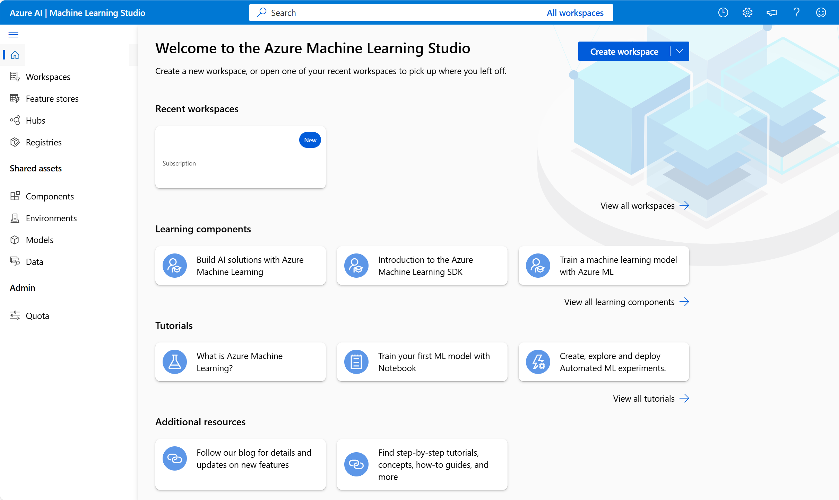
What is Azure Machine Learning?
Azure Machine Learning is a cloud-based platform for machine learning.
Azure Machine Learning Studio is a user interface for accessing Azure Machine Learning capabilities.
Machine learning models trained with Azure Machine Learning can be published as services.
Notes:
After talking to the slide for a minute or so, show students your Azure ML workspace in the Azure Portal, and then show them Azure ML Studio (ml.azure.com)
Microsoft Azure Machine Learning is a cloud service for training, deploying, and managing machine learning models. It's designed to be used by data scientists, software engineers, devops professionals, and others to manage the end-to-end lifecycle of machine learning projects, including:
Exploring data and preparing it for modeling.
Training and evaluating machine learning models.
Registering and managing trained models.
Deploying trained models for use by applications and services.
Reviewing and applying responsible AI principles and practices.
After you've provisioned an Azure Machine Learning workspace, you can use it in Azure Machine Learning studio; a browser-based portal for managing your machine learning resources and jobs.
In Azure Machine Learning studio, you can (among other things):
Import and explore data.
Create and use compute resources.
Run code in notebooks.
Use automated machine learning to train models.
View details of trained models, including evaluation metrics, responsible AI information, and training parameters.
Deploy trained models for on-request and batch inferencing.
Import and manage models from a comprehensive model catalog.

Slide 19
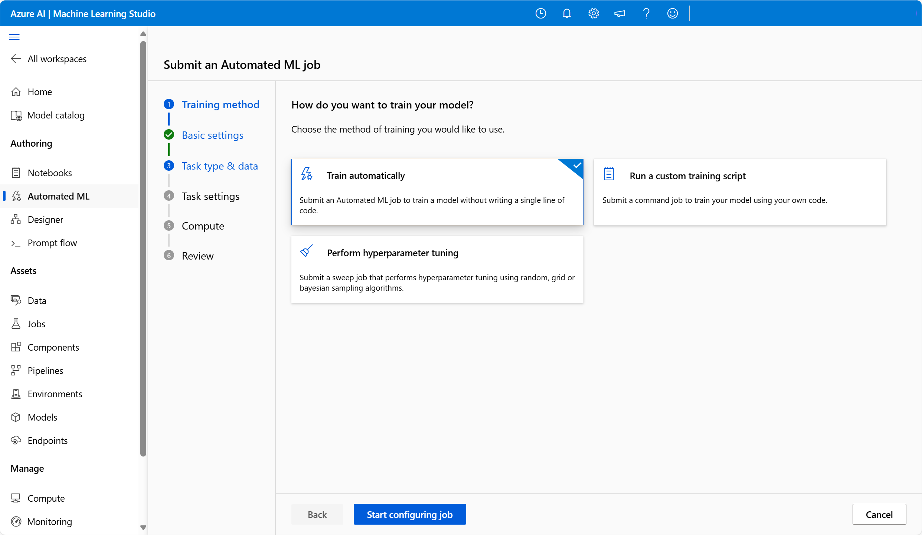
What is Automated Machine Learning?
Provides a step-by-step wizard that helps you run machine learning training jobs
Can be used for many machine learning tasks, including regression, time-series forecasting, classification, computer vision, and natural language processing tasks
Allows you to use your own datasets
Trains ML models that can be deployed as services

Slide 20
What are AI Services?
Describe features of Computer Vision workloads on Azure
Describe features of Natural Language Processing (NLP) workloads on Azure

Slide 21
Describe features of computer vision workloads on Azure (15–20%)
Identify common types of computer vision solution
Identify features of image classification solutions
Identify features of object detection solutions
Identify features of optical character recognition solutions
Identify features of facial detection and facial analysis solutions
Identify Azure tools and services for computer vision tasks
Describe capabilities of the Azure AI Vision service
Describe capabilities of the Azure AI Face detection service
Notes:
Introduction to AI in Azure - Training | Microsoft Learn

Slide 22
Describe features of Natural Language Processing (NLP) workloads (15–20%)
Identify features of common NLP Workload Scenarios
Identify features and uses for key phrase extraction
Identify features and uses for entity recognition
Identify features and uses for sentiment analysis
Identify features and uses for language modeling
Identify features and uses for speech recognition and synthesis
Identify features and uses for translation
Identify Azure tools and services for NLP workloads
Describe capabilities of the Azure AI Language service
Describe capabilities of the Azure AI Speech service
Notes:
Introduction to AI in Azure - Training | Microsoft Learn

Slide 23












AI Services in Microsoft Azure
Standalone resources for specific services
Azure AI Language service
Azure AI Face service
Azure Machine Learning service
Azure AI Translator service
Azure AI Document Intelligence service
Azure OpenAI in Foundry Models
Azure AI Speech service
Azure AI Content Understanding service
Azure AI Foundry Content service
Azure AI Vision service
Azure AI Search service
Azure AI Services
General Azure AI services resource for multiple services
Notes:
- Azure AI services can be used by provisioning (creating) a single general Azure AI services resource.
- To track billing for specific services, you can instead provision a standalone resource for each service
The Azure AI services we cover in this course are:
- Azure Machine Learning and how machine learning forms the foundation of AI’s predictive capabilities.
- Azure AI Foundry, and Azure OpenAI in Foundry Models
- Azure AI Language, including the information extraction, text summarization and classification, question answering, and conversational language understanding
- Azure AI Speech, including text to speech and speech to text
- Azure AI Vision, including the features Image Analysis and Face, and Optical Character Recognition
- Azure AI Content Understanding
- Azure AI Search

Slide 24
What is Azure AI Language?
Azure AI Language is a part of the Azure AI services offerings that can perform advanced natural language processing over unstructured text. The text analysis features include:
Named entity recognition identifies people, places, events, and more. This feature can also be customized to extract custom categories.
Entity linking identifies known entities together with a link to Wikipedia.
Personal identifying information (PII) detection identifies personally sensitive information, including personal health information (PHI).
Language detection identifies the language of the text and returns a language code such as "en" for English.
Sentiment analysis and opinion mining identifies whether text is positive or negative. (Sentiment Score: 0.0 = Negative, 0.5 = Neutral, 1.0 = Positive)
Summarization summarizes text by identifying the most important information.
Key phrase extraction lists the main concepts from unstructured text.
Notes:
Azure AI Language service provides pretrained and customizable deep learning models to analyze text. These models use tokens and embeddings to turn words into numerical representations. Deep learning models perform calculations on these numerical representations to provide responses returned in natural language.
Text Analysis encompasses many capabilities, including:
- identifying the predominant language of the text
- identifying the sentiment of the text
- identifying key phrases
- identifying entities
The slide shows examples using the sentence “I had a wonderful vacation in France”.
Azure AI Language capabilities can be tested in Language Studio (https://language.cognitive.azure.com).

Slide 25



Translation
Use the text translation capabilities of Azure AI Translator service to translate text from one language to others.
English → French
Have a good day → Bonne journée
Use the speech translation capabilities of Azure AI Speech service to generate translated speech.
Input audio (English) → Output audio (French)
Notes:
Microsoft provides Azure AI services that support translation. Specifically, you can use the following services:
The Azure AI Translator service, which supports text-to-text translation.
The Azure AI Speech service, which enables speech to text and speech-to-speech translation.
Azure AI Translator is easy to integrate in your applications, websites, tools, and solutions. The service uses a Neural Machine Translation (NMT) model for translation, which analyzes the semantic context of the text and renders a more accurate and complete translation as a result.
You can use Azure AI Speech to translate spoken audio from a streaming source, such as a microphone or audio file, and return the translation as text or an audio stream. This enables scenarios such as real-time closed captioning for a speech or simultaneous two-way translation of a spoken conversation.

Slide 26

Speech Recognition and Synthesis
Use the speech-to-text capabilities of the Speech service to transcribe audible speech to text
Use the text-to-speech capabilities of the Speech service to generate audible speech from text
Notes:
https://learn.microsoft.com/training/modules/recognize-synthesize-speech/
The Speech service provides a Speech-to-Text API that you can use to implement text recognition functionality. The service supports text transcription in more than 60 languages. {A speech bubble with an arrow pointing to the text "Use the speech-to-text capabilities of the Speech service to transcribe audible speech to text" is displayed}
Conversely, the Text-to-Speech API can synthesize audible speech from text, with the option to specify regionally appropriate voices for human-like pronunciation {The text "Use the text-to-speech capabilities of the Speech service to generate audible speech from text" is displayed with an arrow pointing to a speech bubble}

Slide 27

Conversational AI
Conversational AI describes solutions that enable a dialog between AI and a human.
Use Azure AI Language’s Question Answering capabilities to define a knowledge base of question-and-answer pairs.
Use Azure AI Language’s Conversational Language Understanding capabilities to create a language model that can interpret natural language commands.
Switch the light on.
Entity
Intent
Utterance
Notes:
You can use the Language service to define a knowledge base of question and answer pairs. You can create the knowledge base by entering questions and answers, or you can import an existing Frequently Asked Questions (FAQ) list. You can also augment your questions and answers with built in chit-chat sources that include common conversational exchanges.
Use the next slide to cover conversational language understanding.
The Language service enables you to train a language model that can interpret natural language commands.
The language model consists of three primary components:
Utterances are phrases that a user might say or type – for example, "switch the light on".
Entities are specific items that are referenced in an utterance, for example a language model for a home automation application might recognize household devices such as a light or a fan.
An intent identifies the desired action for an utterance. For example, to switch something on.

Slide 28



Azure AI Options for Reading Text
Azure AI Vision Image Analysis
Azure AI Document Intelligence
Azure AI Content Understanding
Identify text and its location in scanned documents
Find and read text in photographs
Combine with other image analysis features to implement a digital asset management (DAM) solution
Design to support form processing by extracting fields and associated values from documents
Use prebuilt models for common document types
Create custom models for your specific requirements
Use multimodal content extraction capabilities to analyze documents, forms audio, video, and images.
Create custom analyzers to extract specific content or fields tailored to business needs
Notes:
Covered in more detail over next three slides.

Slide 29
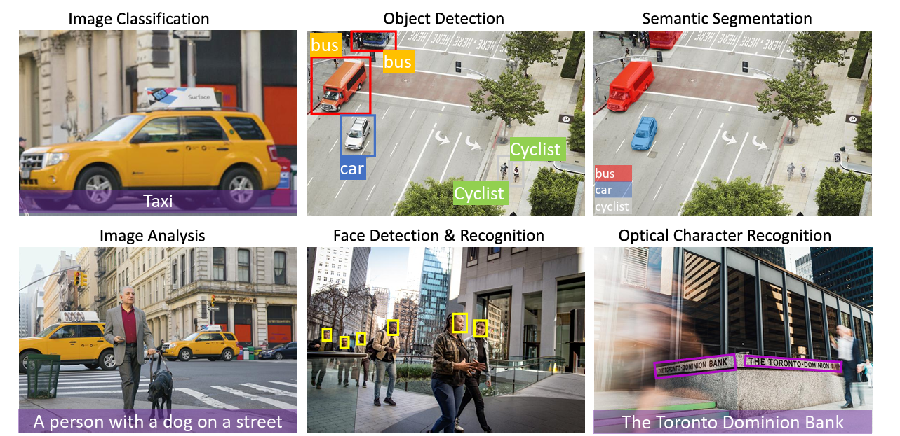
Azure AI Vision Service
Notes:
We’ll cover some of the key capabilities of these computer vision related services in the rest of this module.
For more details of the capabilities of these AI services, see the documentation at:
Azure AI Vision documentation - Quickstarts, Tutorials, API Reference - Azure AI services
What is Image Analysis? - Azure AI services | Microsoft Learn
What is the Azure AI Face service? - Azure AI services | Microsoft Learn
Optical Character Recognition (OCR)

Slide 30
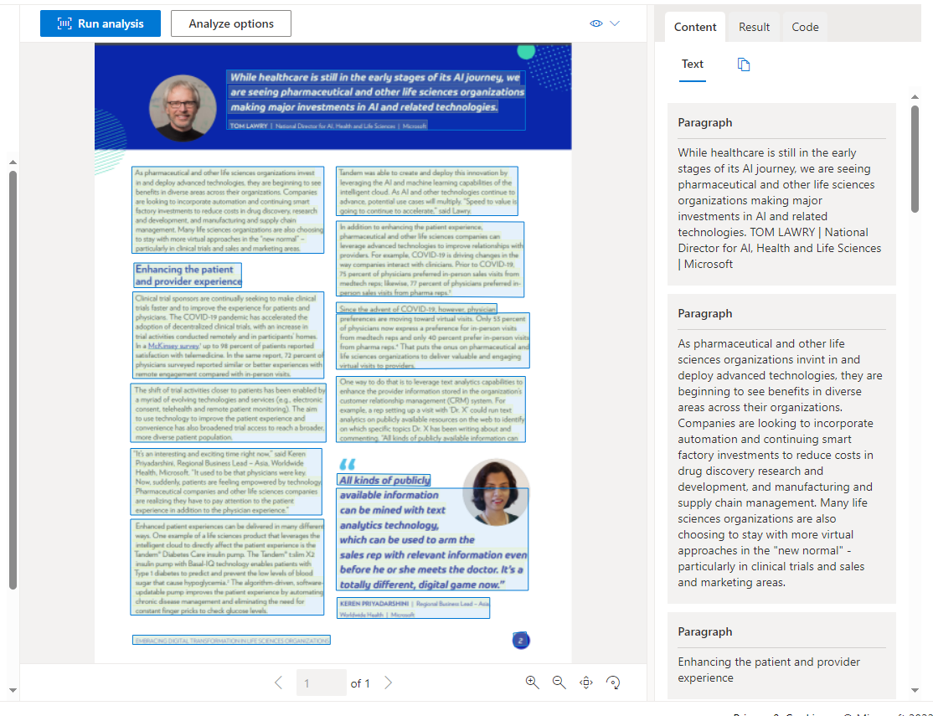
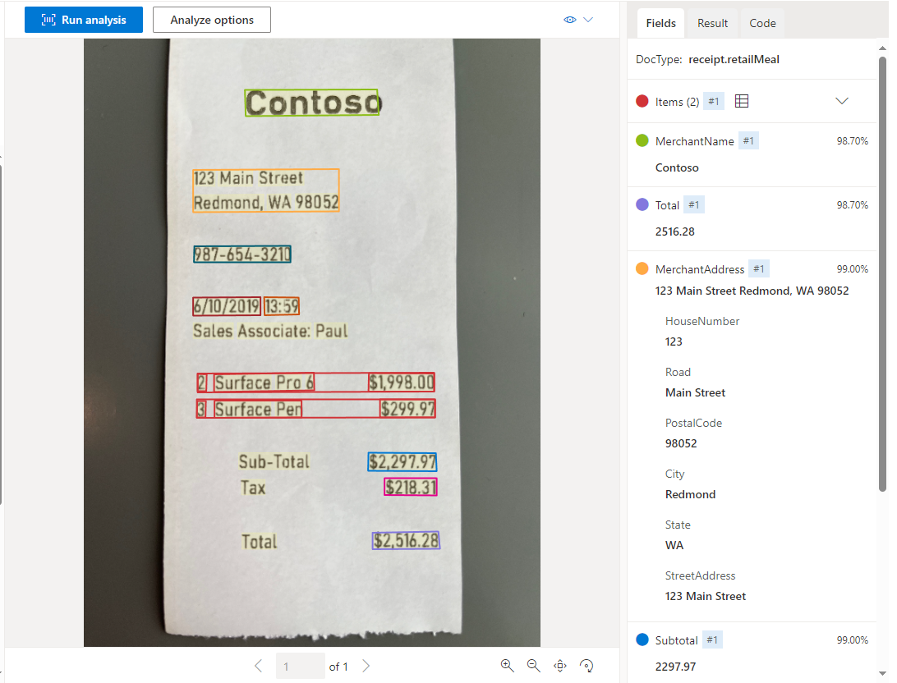
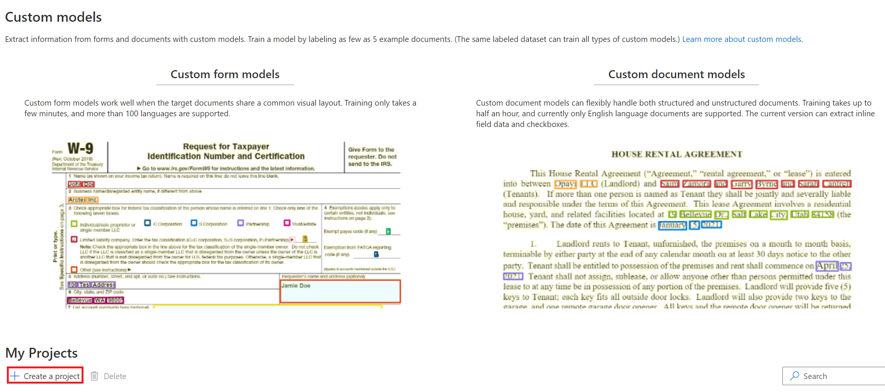
Azure AI Document Intelligence Service
Document Analysis
Regions of interest and relationships.
Configure Analyze options for free and chargeable analysis
Returns structured data representations.
Prebuilt Models
Train models with at least five sample data.
Identify fields of interest to your organization.
Custom Models
Invoices and IDs
Receipts
Extracts key-value pairs.
Notes:
Document Intelligence automatically reads, understands, and analyses business documents
Explain that Document Intelligence is made up of three related services:
- Document analysis
- Prebuilt models – machine learning models trained for specific types of forms, such as receipts (including hotel receipts, gas receipts, etc), invoices, ID.
- Text and field names are identified
- Available as JSON for input into a database
- Custom models
- Train with as few as five sample forms
- Requires an Azure storage account
- Can customize the machine learning models for forms common in your organization

Slide 31
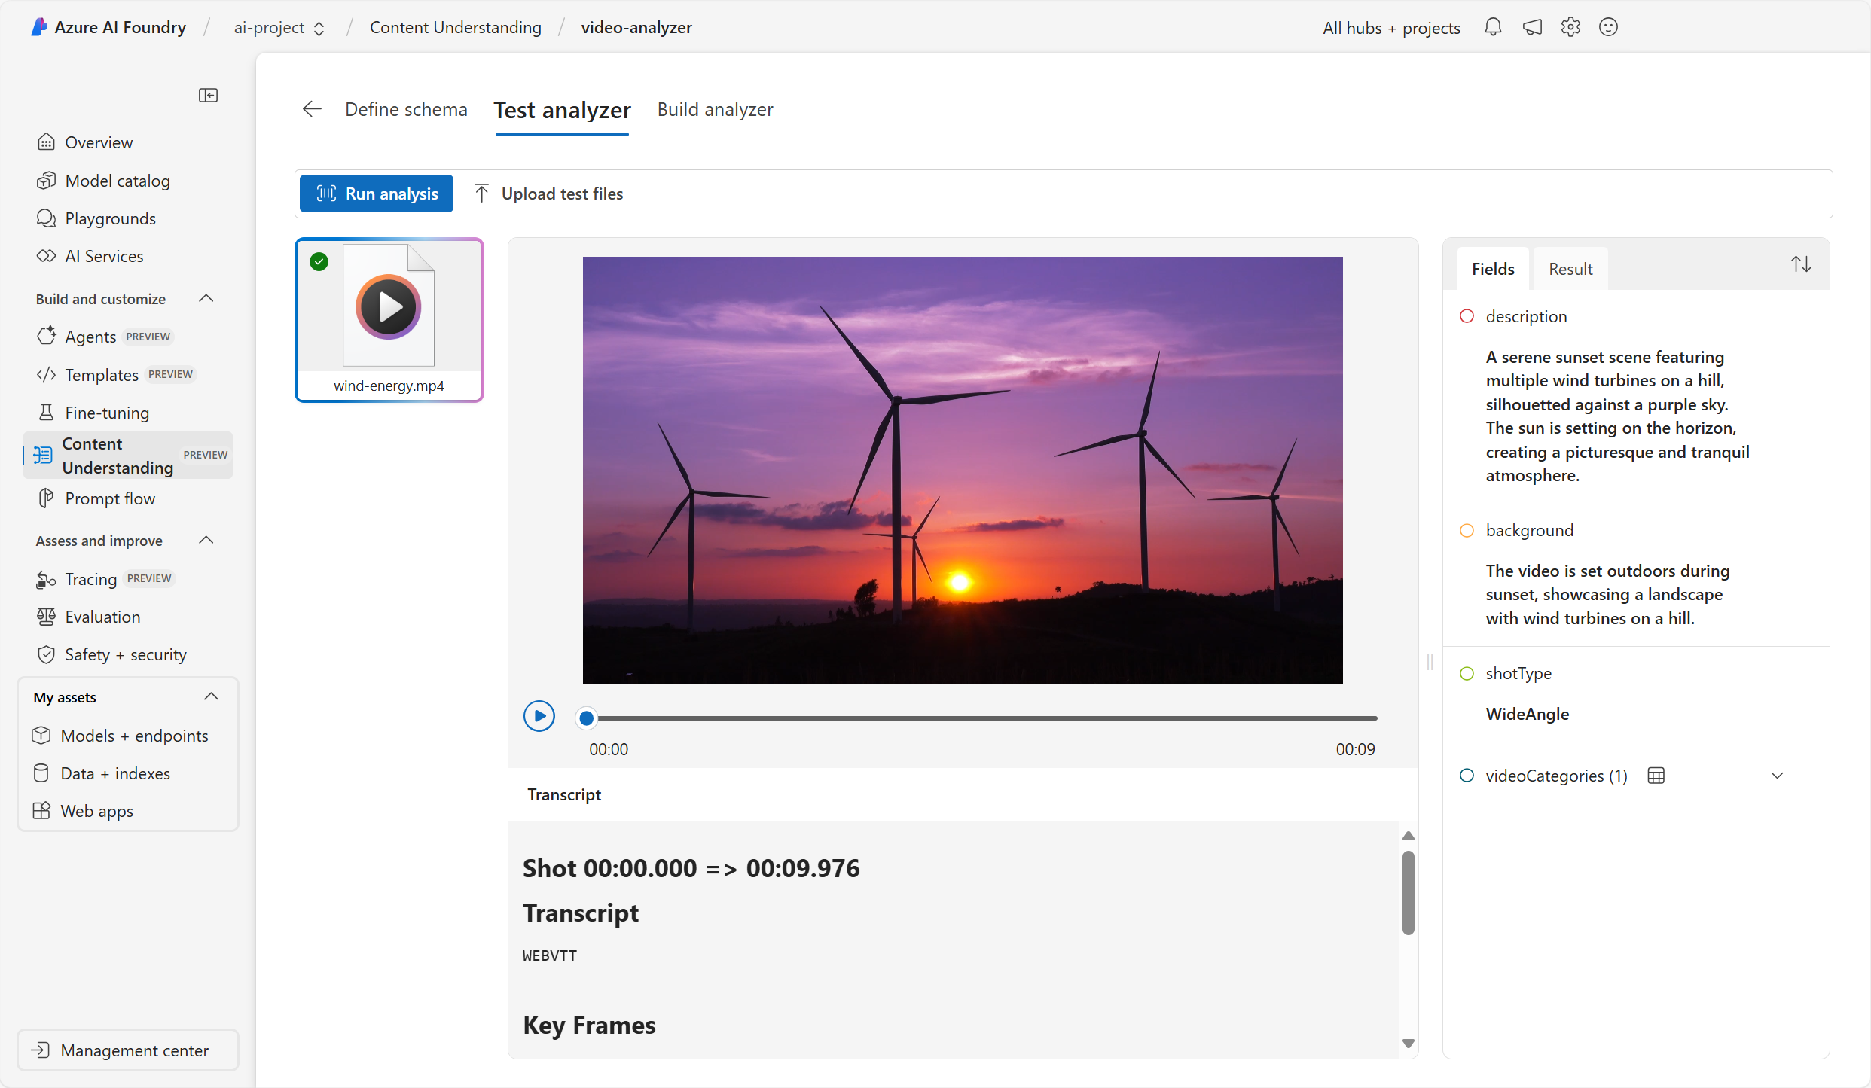
Azure AI Content Understanding service
Notes:
Azure AI Content Understanding uses state-of-the-art AI models to analyze content in multiple formats, including:
Text-based forms and documents
Audio
Images
Video
Azure AI Content Understanding's document analysis capabilities go beyond simple OCR-based text extraction to include schema-based extraction of fields and their values. In addition to text-based documents, Azure AI Content Understanding is capable of analyzing audio files to provide transcriptions, summaries, and other key insights. Azure AI Content Understanding supports analysis of images and video to extract information based on a custom schema. For example, you could analyze images of a video conference to extract details of attendance, location, and other information.

Slide 32
Introduction to generative AI concepts
Describe features of Generative AI workloads on Azure
Notes:
In this module you'll explore the way in which large language models (LLMs) enable AI applications and services to generate original content based on natural language input. You’ll also learn about generative AI chat-based assistants and agents that are integrated into applications to help users find information and perform business tasks efficiently.
https://learn.microsoft.com/training/modules/fundamentals-generative-ai/

Slide 33
Describe features of generative AI workloads on Azure (20–25%)
Identify features of generative AI solutions
Identify features of generative AI models
Identify common scenarios for generative AI
Identify responsible AI considerations for generative AI
Identify generative AI services and capabilities in Microsoft Azure
Describe features and capabilities of Azure AI Foundry
Describe features and capabilities of Azure OpenAI service
Describe features and capabilities of Azure AI Foundry model catalog
Notes:
Introduction to generative AI for trainers - Training | Microsoft Learn
Azure OpenAI in Foundry Models | Microsoft Azure

Slide 34
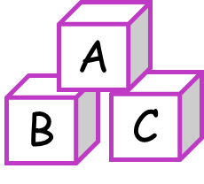


What is Generative AI?
Language model
Natural language generation
Image generation
Code generation
Write a cover letter for a job application
Create a logo for a florist business
Write Python code to add two numbers
Dear <recipient>,
Please find enclosed my application for the role of …
def add(n1, n2):
result = n1 + n2;
return result;
Daisy’s
Flowers
Notes:
AI imitates human behavior by using machine learning to interact with the environment and execute tasks without explicit directions on what to output. Generative AI is a subset of AI in which an AI model creates original content in response to a natural language prompt. Generative AI applications take in natural language input, and return appropriate responses in a variety of formats:
Natural language generation
To generate a natural language response, you might submit a prompt such as "Give me three ideas for a healthy breakfast including peppers.“ or “Write a cover letter for my resume.”
Image generation
Some generative AI applications can interpret a natural language request and generate an appropriate image. For example, you might submit a request like "Create an image of an elephant eating a burger“ or “Create a logo for a florist business”
Code generation
Some generative AI applications are designed to help software developers write code. For example, you could submit a request like "Show me how to code a game of tic-tac-toe with Python“ or “Write Python code to add two numbers”

Slide 35
Plan a Responsible Generative AI Solution
Four stage process to develop and implement a plan for responsible AI are:
Identify
Measure
Mitigate
Operate
Potential harms that are relevant to your planned solution.
The presence of these harms in the outputs generated by your solution.
The harms at multiple layers in your solution to minimize their presence and impact.
The solution responsibly by defining and following a deployment and operational readiness plan.
Notes:
The Microsoft guidance for responsible generative AI is designed to be practical and actionable. It defines a four stage process to develop and implement a plan for responsible AI when using generative models. The four stages in the process are:
Identify potential harms that are relevant to your planned solution.
Measure the presence of these harms in the outputs generated by your solution.
Mitigate the harms at multiple layers in your solution to minimize their presence and impact, and ensure transparent communication about potential risks to users.
Operate the solution responsibly by defining and following a deployment and operational readiness plan.
These stages correspond closely to the functions in the NIST AI Risk Management Framework.
These stages are meant to be developed with the six Responsible AI principles in mind: https://learn.microsoft.com/training/modules/fundamentals-generative-ai/6c-responsible-ai

Slide 36
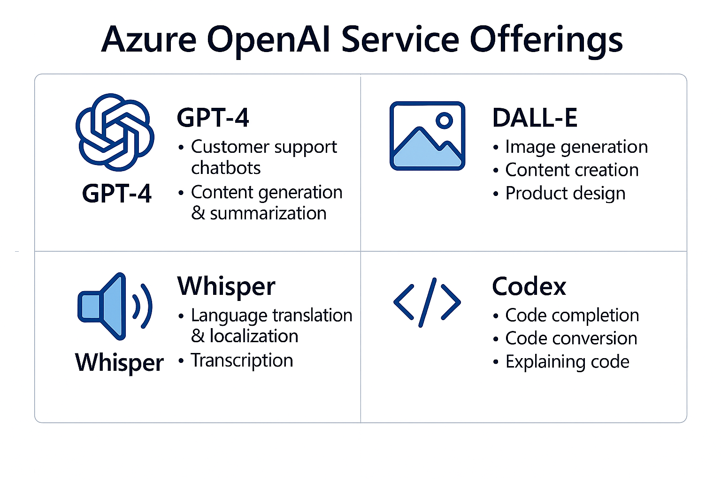
Azure OpenAI Core Services
Notes:
What is Azure OpenAI in Azure AI Foundry Models? | Microsoft Learn
Azure OpenAI Service offers a suite of powerful AI models and tools integrated into Microsoft Azure, enabling businesses to build intelligent applications with enterprise-grade security, scalability, and compliance. Here's a breakdown of the key services and models available, along with their primary use cases:
Core Services and Models in Azure OpenAI
Azure OpenAI provides access to several foundational and advanced models:
GPT-3.5 Turbo & GPT-4: For natural language understanding and generation.
DALL·E: For image generation from text prompts.
Whisper: For speech-to-text transcription.
Codex (Davinci, Babbage): For code generation and understanding.
Function Calling & RAG (Retrieval-Augmented Generation): For integrating external data sources and structured outputs. [Azure Open...soft Azure]
These models are accessible via APIs and can be fine-tuned or embedded into applications using Azure AI Foundry and other Azure services.
Top Use Cases
1. Customer Support Chatbots
Automate responses to FAQs.
Provide real-time coaching and post-call summaries.
Reduce support costs and improve customer satisfaction. [Top 7 Use...plications]
2. Content Generation & Summarization
Generate blogs, emails, product descriptions.
Summarize long documents or transcripts.
Used in marketing, journalism, and education. [Top 7 Use...plications]
3. Code Generation & Review
Assist developers with code suggestions and debugging.
Automate code reviews and documentation.
Enhance productivity in software development. [Top 7 Use...plications]
4. Semantic Search
Build intelligent search engines that understand context.
Improve accuracy in document retrieval and knowledge bases. [Top 7 Use...plications]
5. Language Translation & Localization
Translate documents and interfaces in real-time.
Support global teams and multilingual applications. [Top 7 Use...plications]
6. Data Analysis & Interpretation
Convert raw data into natural language insights.
Help decision-makers understand trends and metrics. [Top 7 Use...plications]
7. Internal Knowledge Assistants
Answer employee queries using internal documentation.
Improve onboarding and internal communication. [Top 7 Use...plications]
8. Document Processing
Extract structured data from unstructured documents.
Automate workflows in finance, healthcare, and legal domains. [What is Az...fits 2025?]
9. Multimodal Applications
Combine text, image, and audio inputs for richer interactions.
Used in accessibility tools and creative applications. [Azure Open...soft Azure]
10. Content Safety & Governance
Apply configurable filters for hate, violence, sexual, and self-harm content.
Ensure responsible AI usage in production environments. [What is Az...fits 2025?]

Slide 37
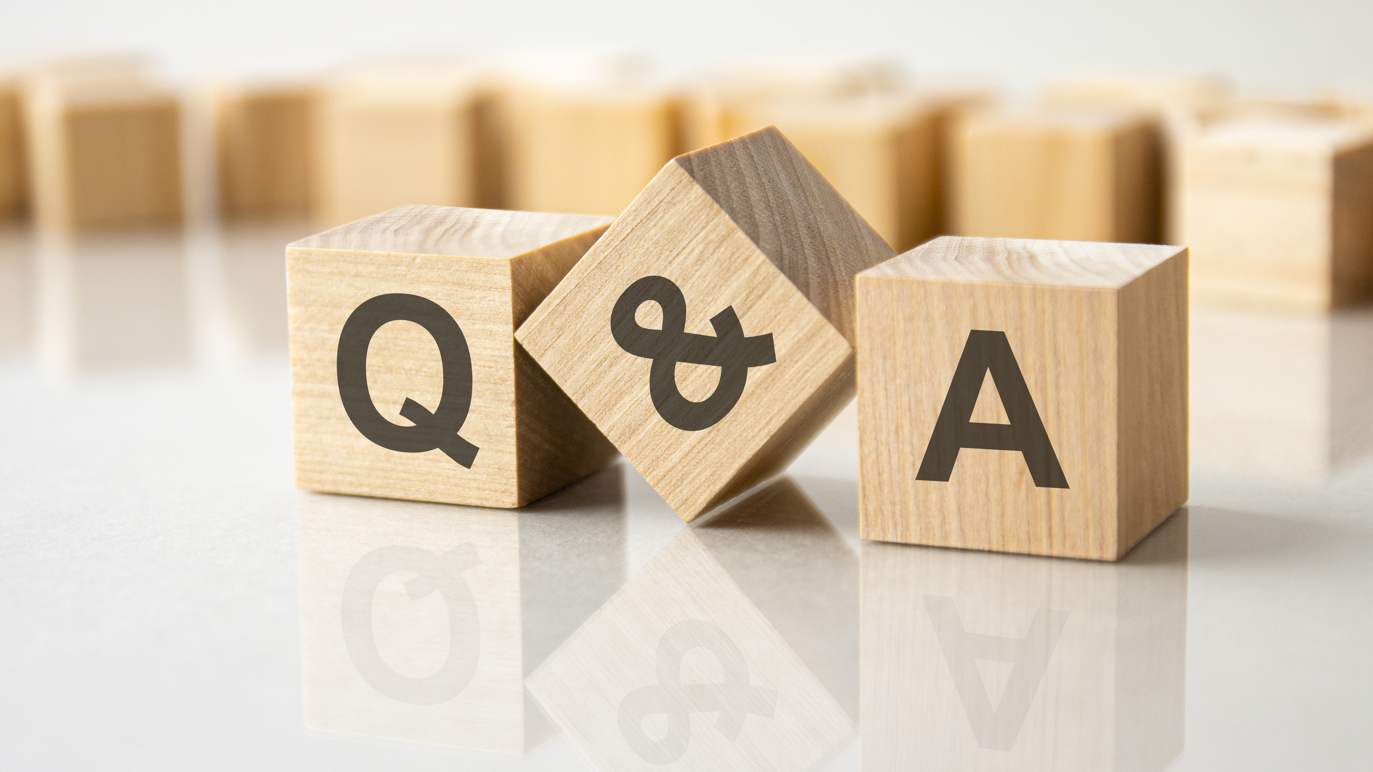

Slide 38
Thank you!

